Slide 1
BOOTSTRAP
Subject: Web Technology I
Subject Teacher: Mr. S.S.Rabade

Slide 2
What is Responsive Web Design?
Responsive web design makes your web page look good on all devices.
Responsive web design uses only HTML and CSS.
Responsive web design is not a program or a JavaScript.
Designing For The Best Experience For All Users

Slide 3
What is The Viewport?
The viewport varies with the device, and will be smaller on a mobile phone than on a computer screen.
Before tablets and mobile phones, web pages were designed only for computer screens, and it was common for web pages to have a static design and a fixed size.
You should include the following <meta> viewport element in all your web pages:
<meta name="viewport" content="width=device-width, initial-scale=1.0">

Slide 4
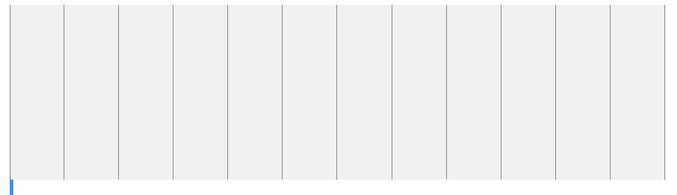
What is a Grid-View?
Many web pages are based on a grid-view, which means that the page is divided into columns:
A responsive grid-view often has 12 columns, and has a total width of 100%, and will shrink and expand as you resize the browser window.

Slide 5
What is a Media Query?
Media query is a CSS technique introduced in CSS3.
It uses the @media rule to include a block of CSS properties only if a certain condition is true.
Example
If the browser window is 600px or smaller, the background color will be lightblue:
@media only screen and (max-width: 600px) { body { background-color: lightblue; } }

Slide 6
What is Bootstrap?
It is a free front-end framework for faster & easier web development
It includes HTML & CSS based design templates for typography, forms, buttons, tables, navigation & may other as well as optional javascript plugin
It gives you the ability to easily create responsive designs.

Slide 7
Advantage
Easy to use
Responsive features
Mobile-first approach
Browser compatiblity

Slide 8
How to use Bootstrap?
You can
Download bootstrap from getbootstrap.com
Include bootstrap from CDN(Content Delivery Network)
Use jQuery

Slide 9
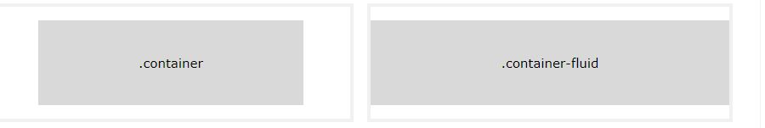
Containers

Slide 10
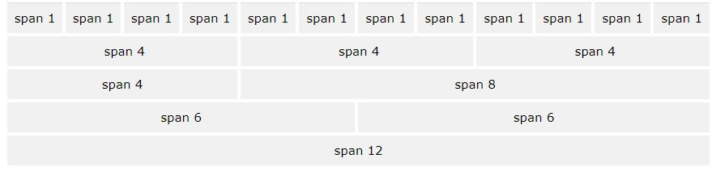
Bootstrap Grid System
Grid System allows up to 12 columns across the page

Slide 11
Grid Classes
The Bootstrap grid system has four classes:
xs (for phones - screens less than 768px wide)
sm (for tablets - screens equal to or greater than 768px wide)
md (for small laptops - screens equal to or greater than 992px wide)
lg (for laptops and desktops - screens equal to or greater than 1200px wide)

Slide 12
Basic Structure of a Bootstrap Grid
The following is a basic structure of a Bootstrap grid:
<div class="row"> <div class="col-*-*"></div> <div class="col-*-*"></div> </div> <div class="row"> <div class="col-*-*"></div> <div class="col-*-*"></div> <div class="col-*-*"></div> </div> <div class="row"> ... </div>

Slide 13
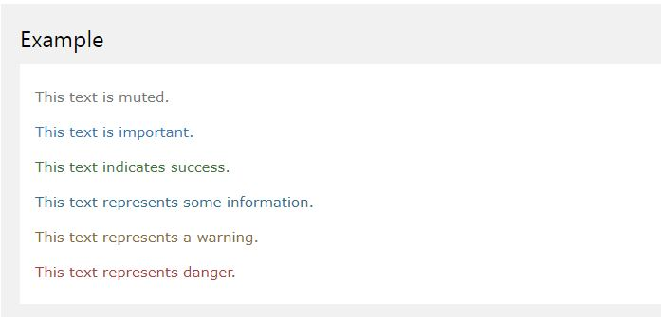
Classes for text colors
.text-muted, .text-primary, .text-success, .text-info, .text-warning, and .text-danger:

Slide 14
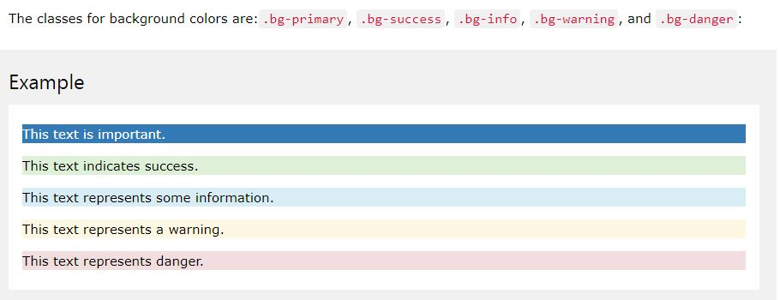
Classes for background colors

Slide 15
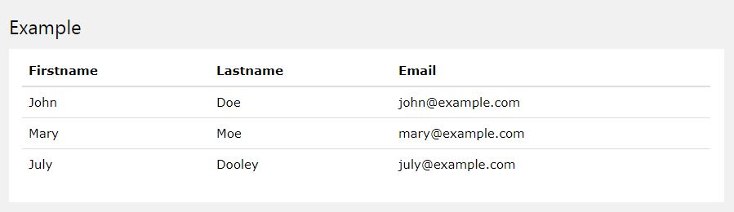
Bootstrap Basic Table
A basic Bootstrap table has a light padding and only horizontal dividers.
The .table class adds basic styling to a table:

Slide 16
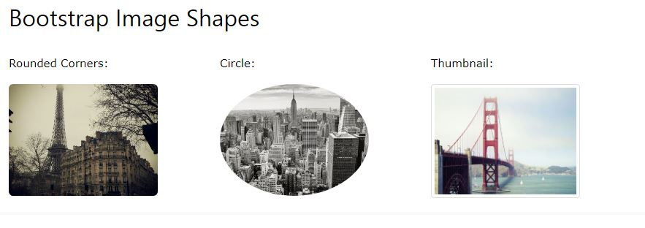
Image Shapes

Slide 17
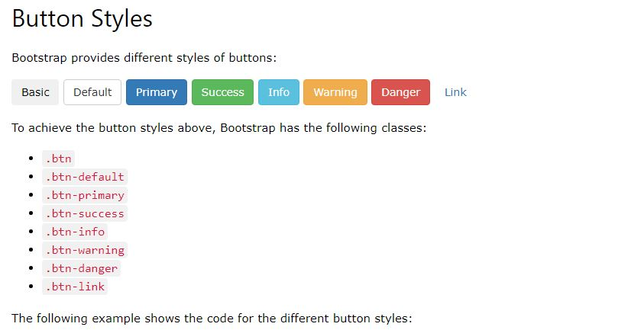
Buttons in bootstrap

Slide 18
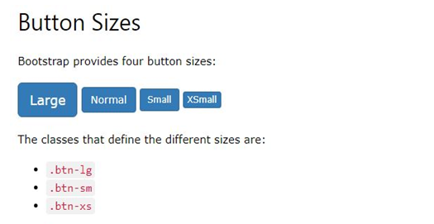
Button size

Slide 19
Card
A card is a flexible and extensible content container
It includes options for headers and footers, a wide variety of content, contextual background colors, and powerful display options.

Slide 20
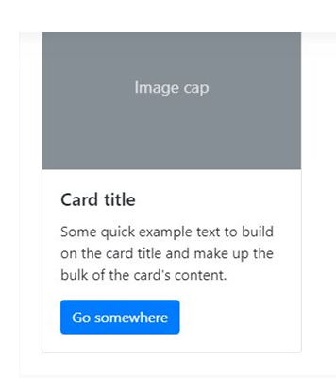
Card Example

Slide 21
THANK YOU…..

